Slide 1
IO organization
Peripheral Devices
I/O Interface
Asynchronous Data Transfer
Modes of Transfer
Priority Interrupt
Direct Memory Access
I/O Processor

Slide 2
Peripheral Devices
Provides an efficient mode of communication between the central system and the outside environment
Peripheral Device: Input or Output devices attached to the computer
Types:
Input device: keyboard, mouse, joystick etc.
Output device: Monitor, printer etc.
Input-Output device: Memory

Slide 3
Input-Output Interface
Provides a method for transferring information between internal storage and external I/O devices.
Provides special communication links for interfacing I/O device with CPU
Purpose of I/O interface is to resolve the differences that exist between CPU and each peripheral
Conversion of signal values (CPU—electronics devices, and peripherals – electromechanical and electromagnetic devices)
Synchronization (data rate is different)
Data codes and formats in peripherals differ from the word format in the CPU and memory
The operating modes of peripherals are different from each other an each must be controlled so as not to disturb the operation of other peripherals connected to CPU (Device selection)

Slide 4
I/O bus and Interface Modules
I/O bus provides communication links between the CPU and several PD.
I/O bus consists of
Data bus
Address bus
Control bus
Each Peripheral device (PD) are connected to the I/O bus through its associated Interface
Function of interface:
Decodes the address and control received from the I/O bus
Interprets them for the peripherals
Provides signals for the peripheral controller
Synchronize the data flow and supervises the transfer between peripheral and processor.

Slide 5
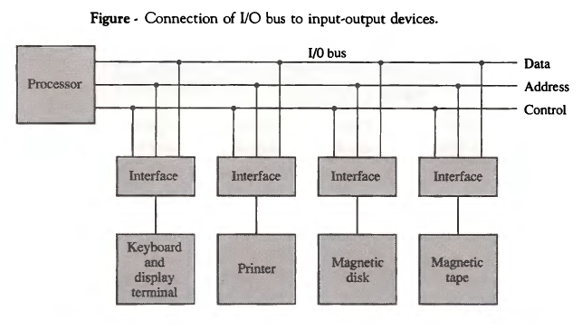
Contd..

Slide 6
Contd..
To communicate with particular device, CPU issues an address on address line and function code (AKA I/O command) on control lines of that particular device
Each interface associated with PD monitors address line
If it detects its own address then it activates the path between bus lines and PD
The Selected device responds to the function codes and proceeds to execute.

Slide 7
Contd..
There are four types of function codes:
Control command
Issued to activate the PD and to inform it what to do
Status command
Used to test various status condition in the interface and the PD
Data output command
Causes the interface to receive the data from the data lines
Interface communicate with PD and send this received data to the PD
Data input command
Causes the interface to place the data from its register to the data lines.
Interface receives the data from PD and store its in buffer

Slide 8
I/O versus Memory Bus
CPU must communicate with both I/O as well as Memory
Both I/O bus as well as Memory bus contains data, address and control lines.
Three ways that computer buses can be used to communicate with memory and I/O
Use two separate buses, one for memory and the other for I/O
Use one common bus for both memory and I/O but have separate control lines for each
Use one common bus for memory and I/O with common control lines

Slide 9
Isolated versus Memory – mapped I/O
Isolated I/O
CPU has separate instructions for I/O data transfer and memory data transfer.
It uses separate address space for I/O and memory operation
Usually I/O mapped I/O is used to map devices like 8255A (PPI), 8251A (USART) etc.
Memory mapped I/O
CPU does not have separate address space for I/O and memory
No specific input or output instructions
The CPU can manipulate I/O data residing in interface registers with the same instructions that are used to manipulate memory words.
Usually memory mapped I/O is used to map memories like RAM, ROM etc.

Slide 10
Asynchronous Data transfer
Control signals are needed to indicate the time at which the data is being transmitted.
Different mechanism
Strobe control
Handshaking

Slide 11
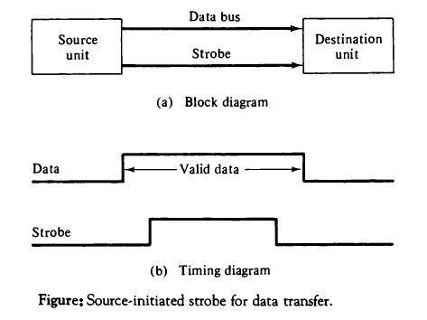
Strobe control
The strobe may be activated by either the source or the destination unit

Slide 12
Contd..
Source initiated strobe for data transfer
Data bus carries binary information from source to destination
Strobe informs the destination unit when a valid data is available in the bus
Source removes data from the data bus a brief period after it disables its strobe pulse
Destination initiated strobe for data transfer
Destination activates the strobe pulse informing the source to provide the data
The source responds by placing the requested binary information on the data bus.

Slide 13
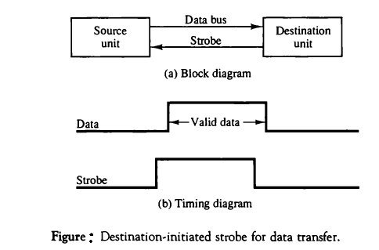
Contd..
Disadvantage
No way to know whether the destination unit has actually received the data item placed in the bus (source initiated strobe)
No to way to know whether the source unit has placed the data on the bus (destination initiated strobe)

Slide 14
Handshaking
Solves problem exists in strobe method by introducing a second control signal that provides a reply to the unit that initiates the transfer
Basic principal of the two-wire handshaking method
One control lines is used to show the validity of data on the data bus. (used by source unit to inform destination)
Another control lines is used to inform the source by destination whether it can accept data.

Slide 15
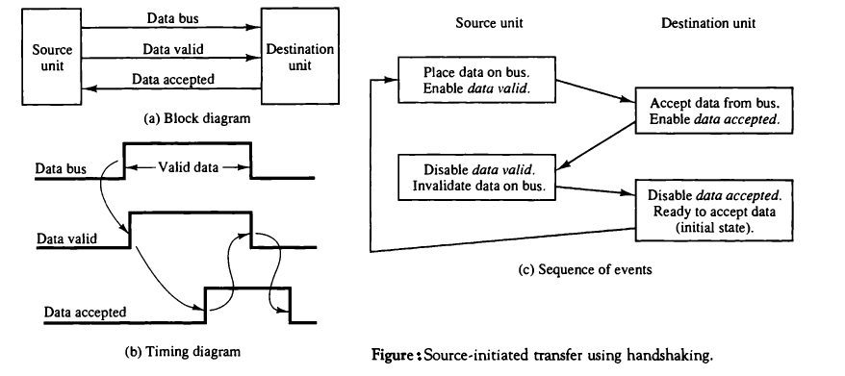
Cont.…

Slide 16
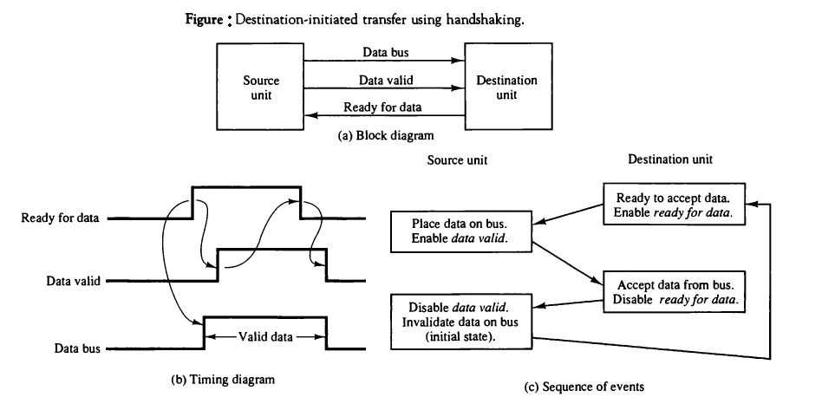
Contd..

Slide 17
Data transfer
Data transfer between source and destination may be
Parallel transfer
Number of bits are transmitted parallely. i.e. to transmit n bits at a time require n separate paths
Serial transfer
Number of bits can be transmitted serially (one bit at a time) through the single paths.
It may be synchronous or asynchronous
In synchronous transmission two units share common clock frequency and bits are transmitted synchronously
In asynchronous transmission each unit is driven by separate clock and the data is transmitted when it is available.

Slide 18
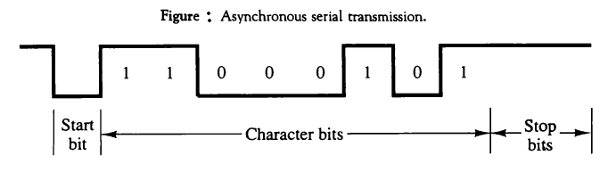
Asynchronous data transfer
Source and destination are driven by separate clock
Character oriented
Slower but cheap
Data overhead high

Slide 19
Assignment
Explain UART with its block diagram in brief.

Slide 20
Modes of transfer
Data transfer to and from peripherals can be done in one of the three possible modes:
Programmed I/O
Interrupt-Initiated I/O
Direct Memory access (DMA)
Programmed I/O
Data transfer takes place under the program control
Requires constant monitoring of the peripheral by the CPU so time consuming process and less efficient one.
Interrupt – Initiated I/O

